Slide 1
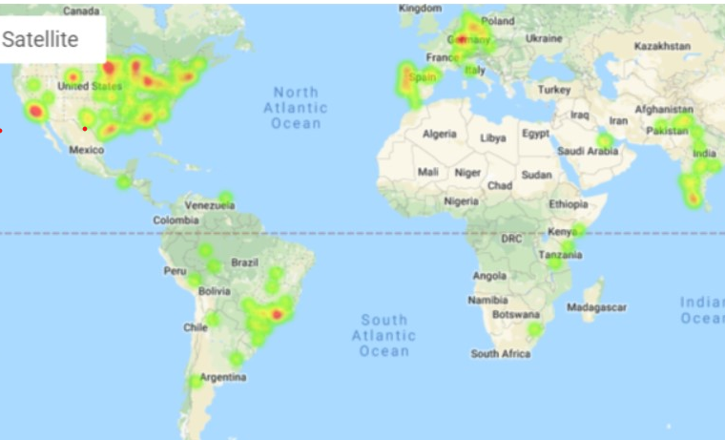
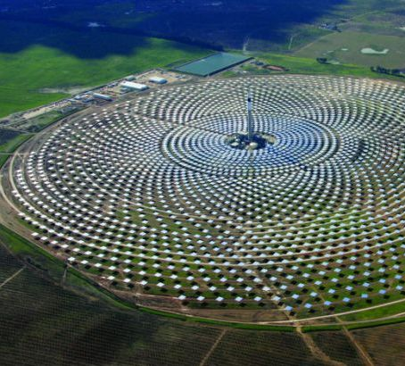
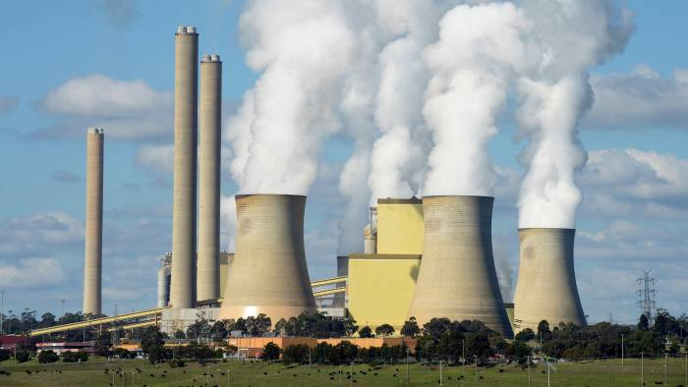
Energy capacity Where are we building?
Maximum energy production capability calculated from power plant commissioning of all fuel types
Source: Global Power Plant Database
Notes:
Discuss the steps you took to analyze the data and answer each question you asked in your proposal Present and discuss interesting figures developed during analysis, ideally with the help of Jupyter Notebook

Slide 2
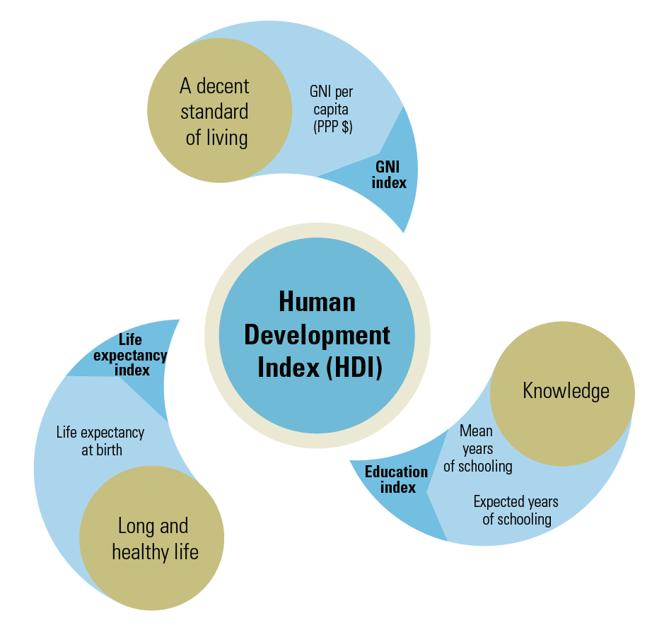
How does hdi look with add capacity and generation?
Let’s take a look at some graphs!
How much of added capacity becomes more generation?
Notes:
Discuss the steps you took to analyze the data and answer each question you asked in your proposal Present and discuss interesting figures developed during analysis, ideally with the help of Jupyter Notebook
Discuss your findings. Did you find what you expected to find? If not, why not? What inferences or general conclusions can you draw from your analysis?

Slide 3
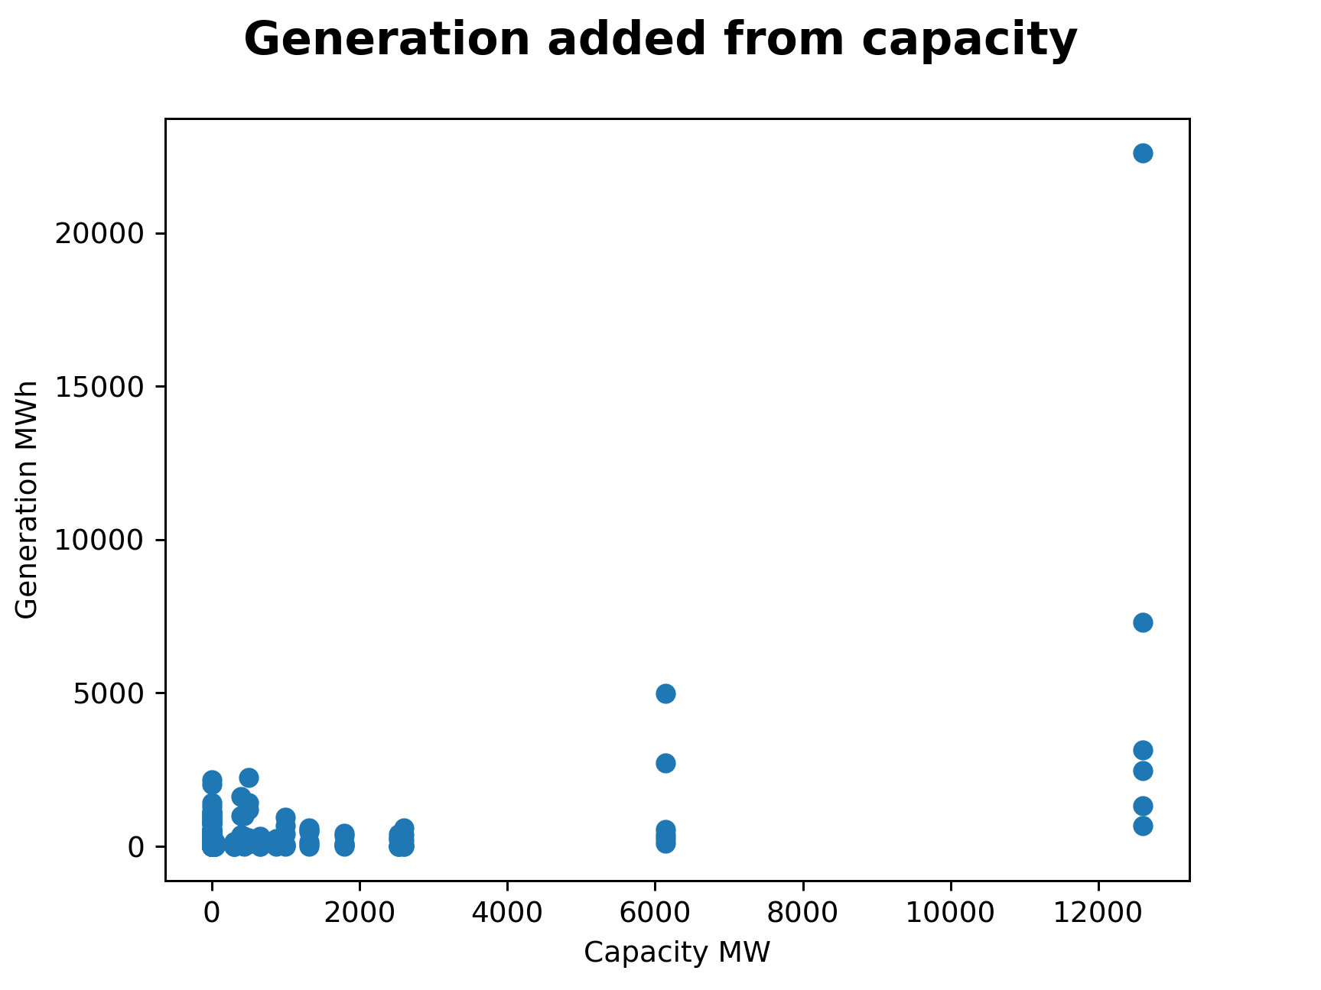
How much more generation when capacity is added
A linear regression reveals the for every MW added to capacity a countries generation/consumption increases by 0.40 MWh. In other words about 40% of added capacity is used.
How much of added capacity becomes more generation?
Notes:
Discuss the steps you took to analyze the data and answer each question you asked in your proposal Present and discuss interesting figures developed during analysis, ideally with the help of Jupyter Notebook
Discuss your findings. Did you find what you expected to find? If not, why not? What inferences or general conclusions can you draw from your analysis?

